Slide 1


Problem 5 – GHZ state
Team : Bamsong🌰
Jeongwon Kim, Beomgyu Choi, Jongwon Park, Doyoung Kim

Slide 2
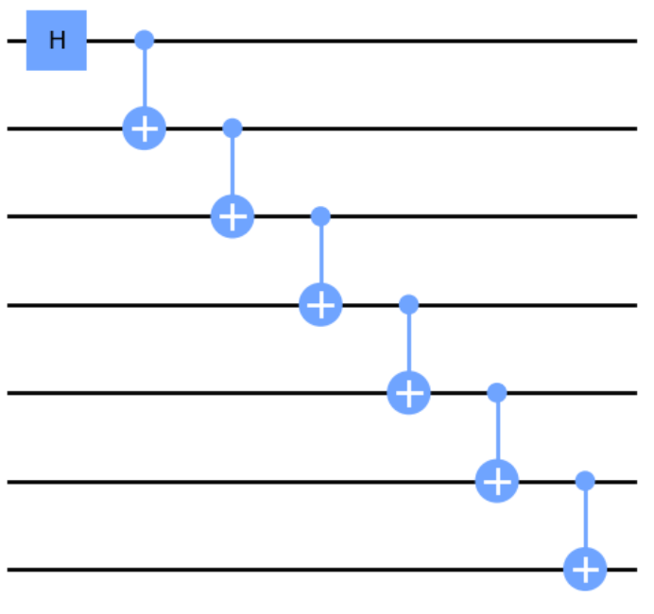
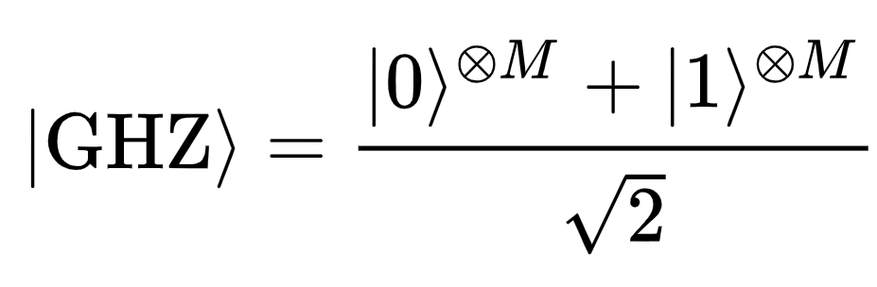


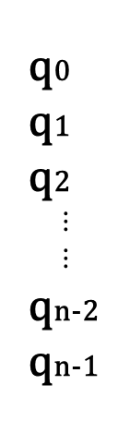

Constructing GHZ State with minimal error
q0
q1
q2
$$⋮$$
$$⋮$$
qn-2
qn-1
Qubit part
Selecting optimal qubit mapping of low noise
$$⋮$$
Gate part
Selecting best gate of low noise through
Pulse Calibration
Pauli Twirling
$$N$$
$$N$$

Slide 3
Constructing GHZ State with minimal error
q0
q1
q2
$$⋮$$
$$⋮$$
qn-2
qn-1
<Qubit part>
Selecting optimal qubit mapping of low noise
$$⋮$$
<Gate part>
Selecting best gate of low noise through
Pulse calibration
Pauli Twirling
$$N$$
$$N$$

Slide 4
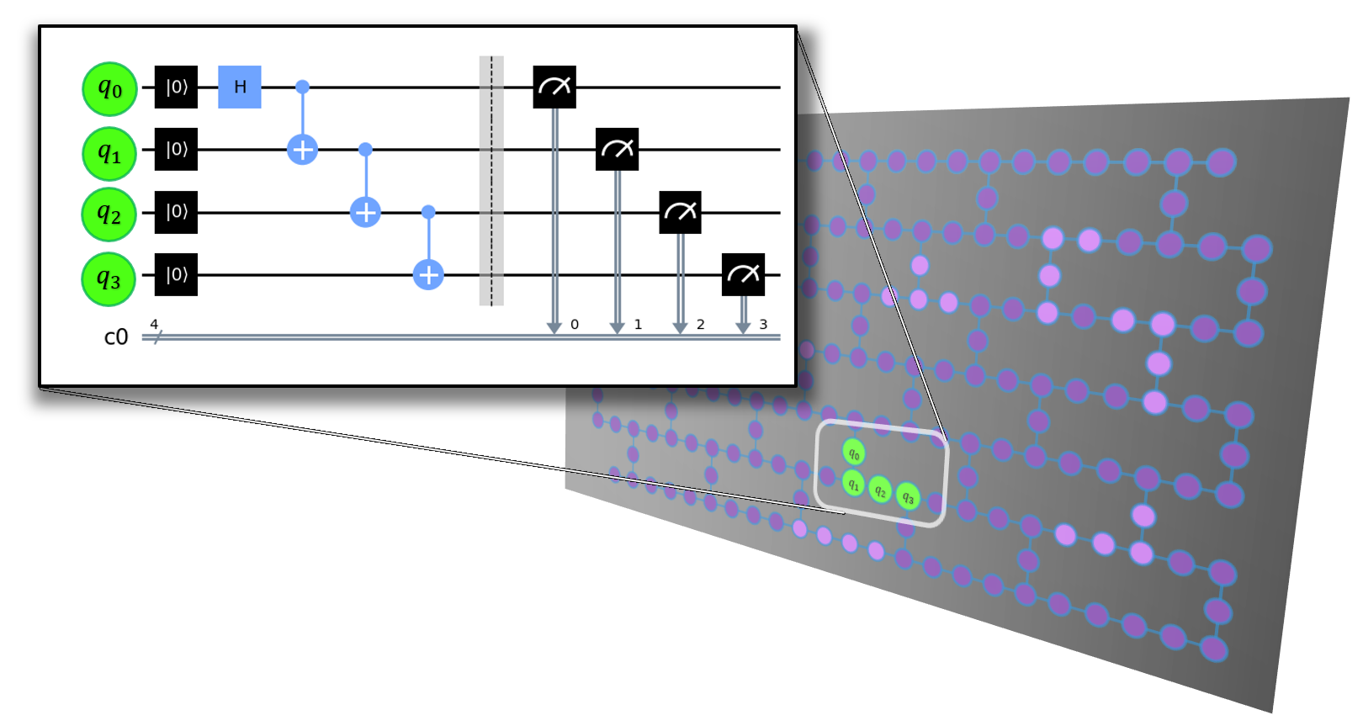
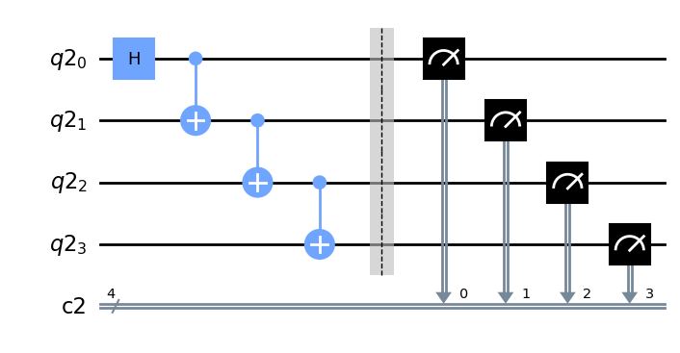
Mapomatic Algorithm for optimal qubit
Automatic mapping of compiled circuits to low-noise sub-graphs
Finding the optimal qubit mapping

Slide 5
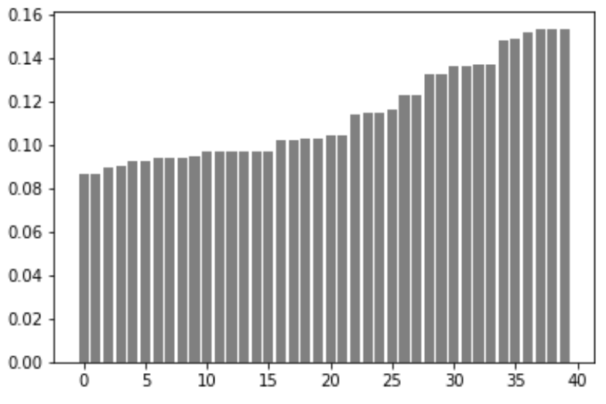
Mapomatic Algorithm for optimal qubit
Qubit combination
[[4, 1, 2, 3],
[0, 1, 2, 3],
[2, 1, 4, 7],
[0, 1, 4, 7],
[3, 2, 1, 4],
[3, 2, 1, 0],
[1, 2, 3, 5],
[7, 4, 1, 2],
[7, 4, 1, 0],
[1, 4, 7, 10],
[1, 4, 7, 6],
[10, 7, 4, 1],
[6, 7, 4, 1],
[4, 7, 10, 12],
[6, 7, 10, 12],
[5, 3, 2, 1],
[2, 3, 5, 8],
[8, 5, 3, 2],
[3, 5, 8, 11],
[3, 5, 8, 9],
[12, 10, 7, 4],
[12, 10, 7, 6],
[7, 10, 12, 13],
[7, 10, 12, 15],
[11, 8, 5, 3],
[9, 8, 5, 3],
[5, 8, 11, 14],
[9, 8, 11, 14],
[13, 12, 10, 7],
[15, 12, 10, 7],
[10, 12, 13, 14],
[15, 12, 13, 14],
[14, 11, 8, 5],
[14, 11, 8, 9],
[8, 11, 14, 13],
[14, 13, 12, 10],
[14, 13, 12, 15],
[12, 13, 14, 11],
[13, 14, 11, 8],
[11, 14, 13, 12]]
Circuit
error rate
Qubit combination

Slide 6
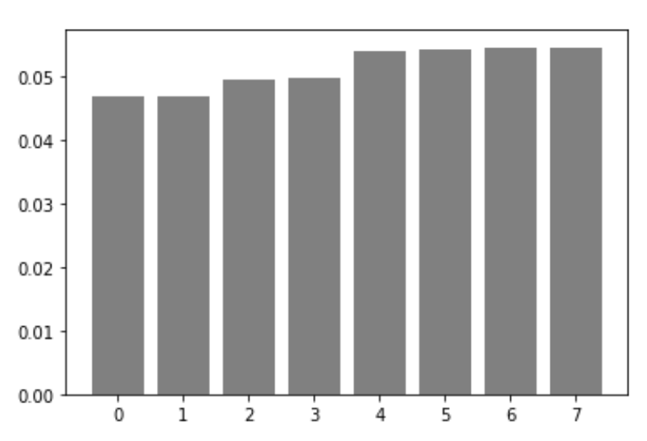
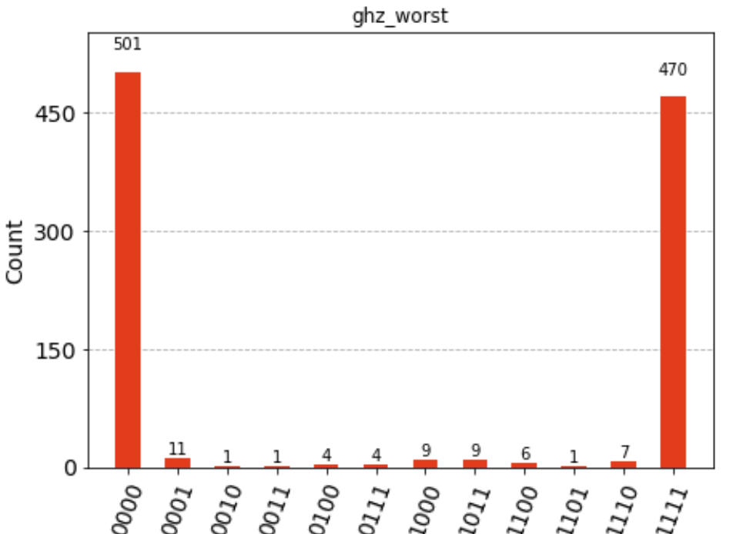
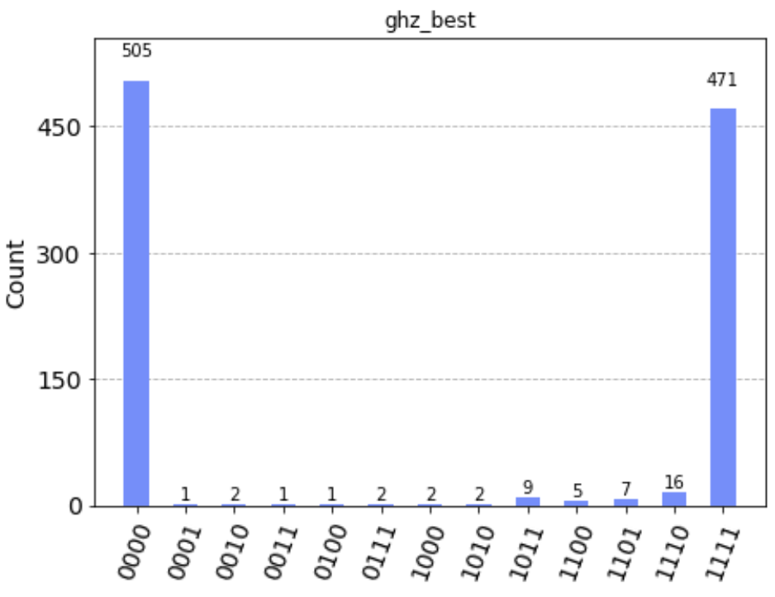
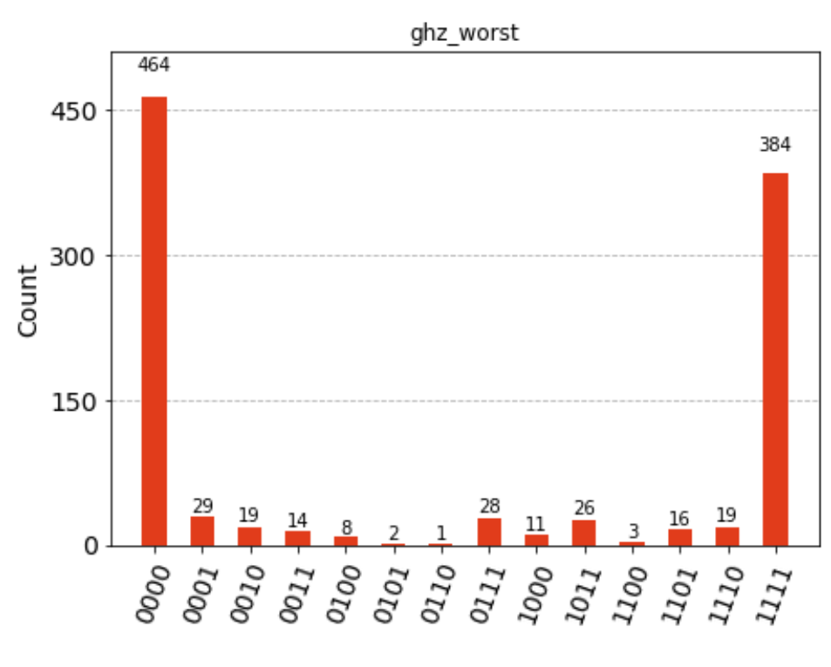
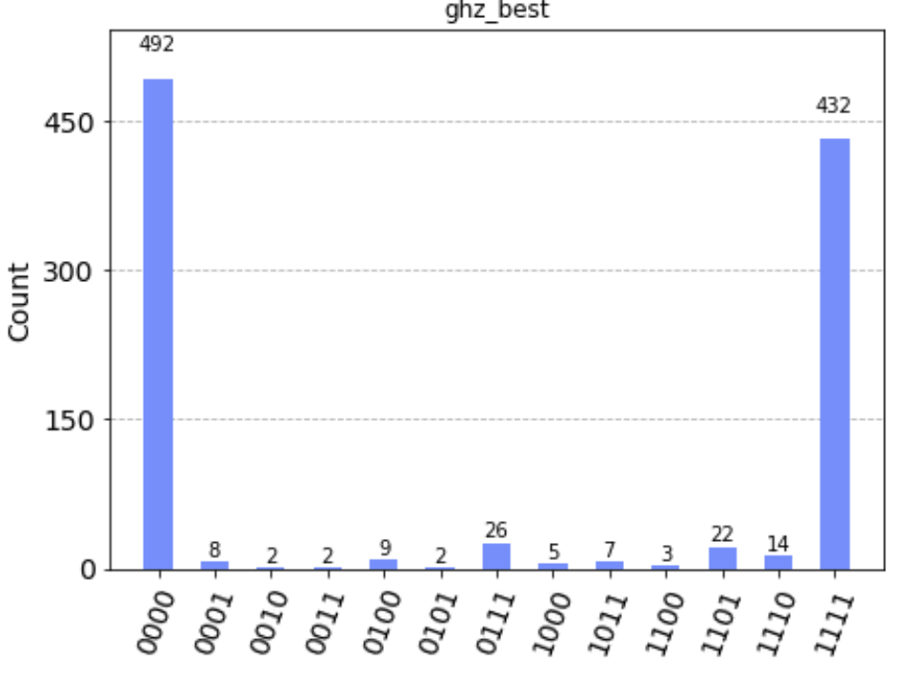
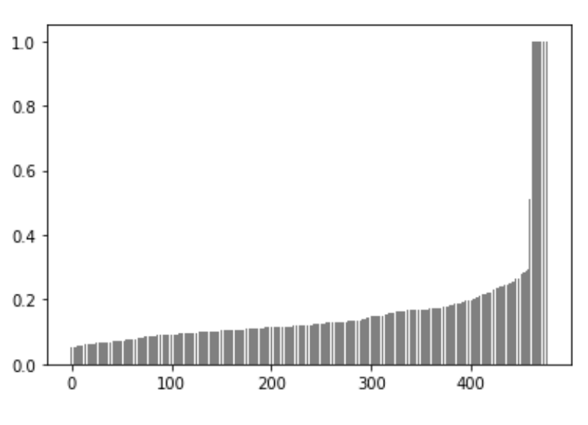
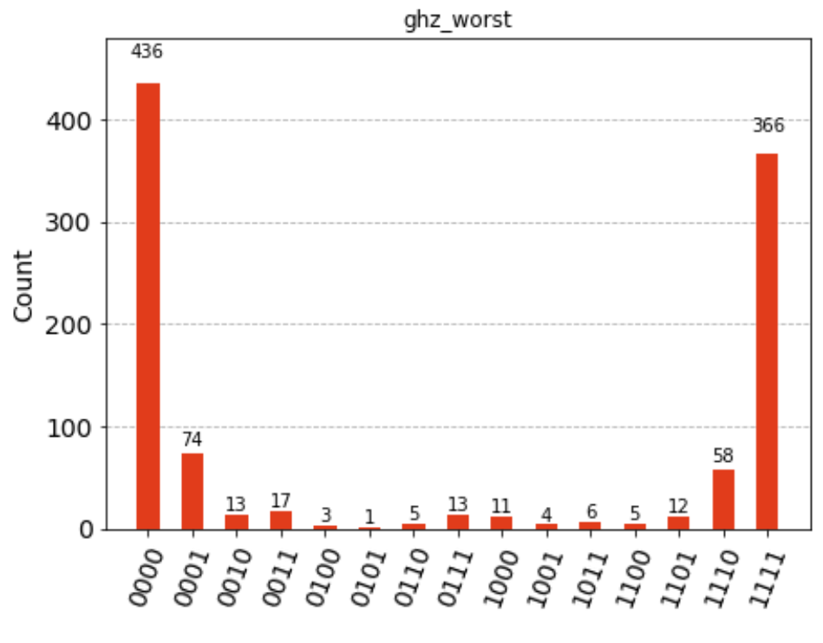
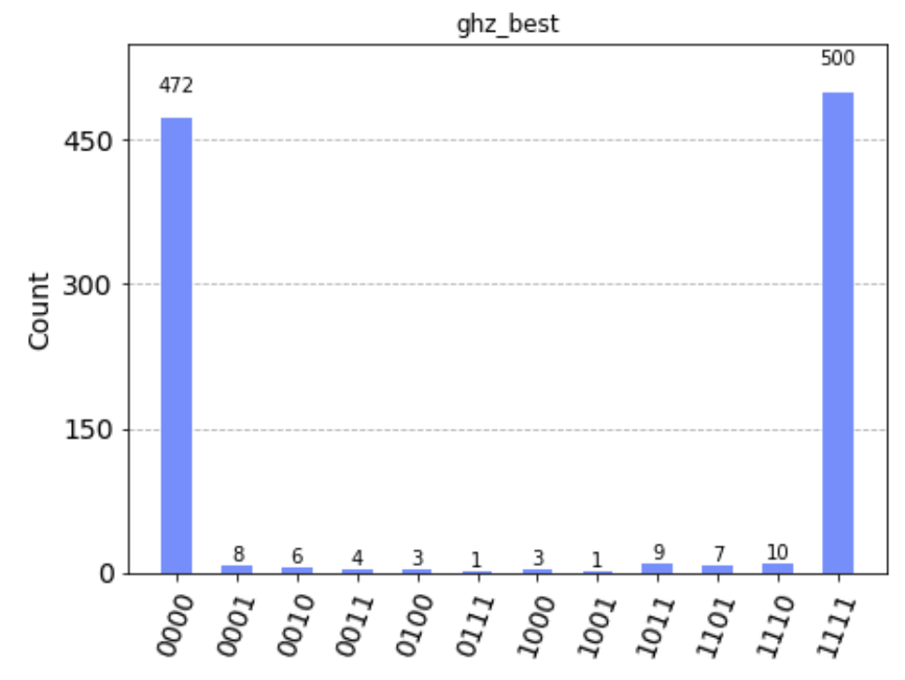



Circuit error rate per Qubit combination
GHZ state Fidelity
Worst combination
Best combination
94.90%
95.31%
0.4% $↑$
Lagos, 7qubits
80.65%
90.21%
9.6% $↑$
Guadalupe, 16qubits
80.17%
94.91%
14.74% $↑$
Washington, 127qubits

Slide 7
Constructing GHZ State with minimal error
q0
q1
q2
$$⋮$$
$$⋮$$
qn-2
qn-1
<Qubit part>
Selecting optimal qubit mapping of low noise
$$⋮$$
<Gate part>
Selecting best gate of low noise through
Pulse calibration
Pauli Twirling
$$N$$
$$N$$

Slide 8
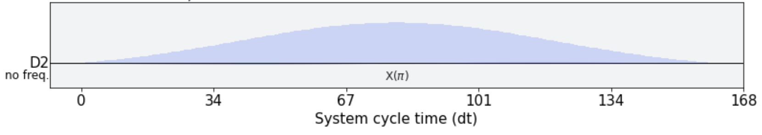
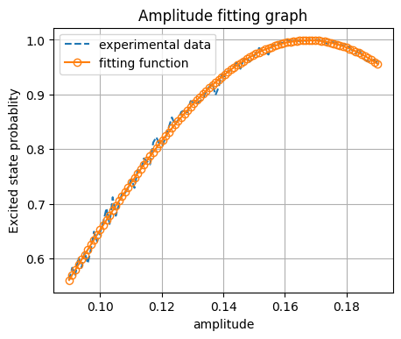
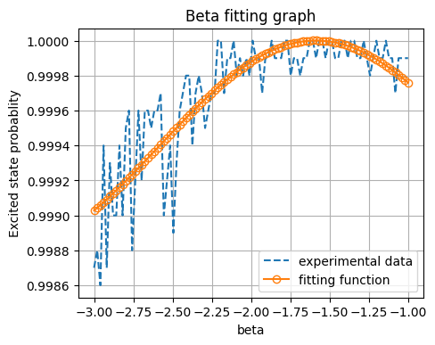
1. X gate calibration
Given Pulse
Duration:160
Width : 40
beta=-1.77 amp=0.19
 | State Fidelity
Original | 96.98%
After amp calibration | 99.76%
After beta calibration | 99.99%

Slide 9
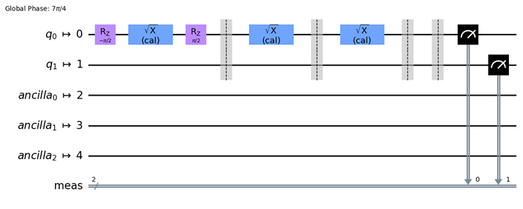
1. H gate calibration
Calibrated X → Calibrated SX → Calibrated H
H

Slide 10
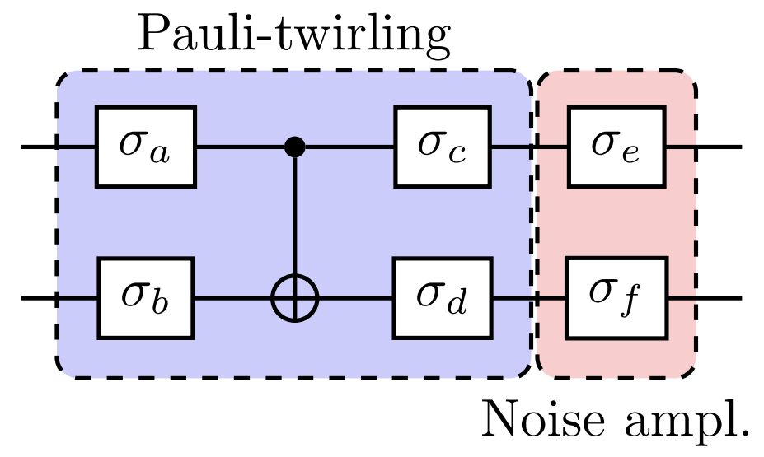
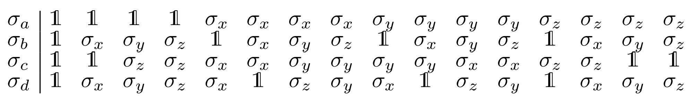
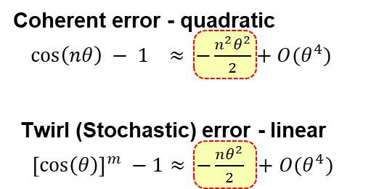
2. CNOT gate Pauli Twirling
Valid combination for Pauli-twirling of the CX gate
Pauli Twirling : Coherent error → Stochastic error
Error increase linearly with the system size ☺

Slide 11
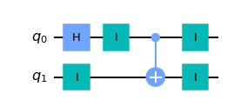




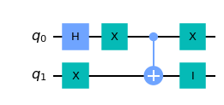










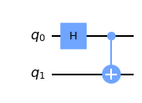
2. CNOT gate Pauli Twirling
Valid combination for Pauli-twirling of the CX gate
16 Pauli-twirling combination resulted by QST
Fidelity: 96.20%
Fidelity: 95.04%
Fidelity: 95.29%
Fidelity: 94.82%
Fidelity: 96.58%
Fidelity: 94.94%
Pauli Twirling
Increase state fidelity!!
Fidelity: 95.16%
Fidelity: 95.57%
Fidelity: 94.25%
Fidelity: 95.11%
Fidelity: 96.36%
Fidelity: 95.68%
Fidelity: 94.87%
Fidelity: 94.93%
Fidelity: 94.43%
Fidelity: 95.80%
Fidelity: 94.82%
Notes:
논문 제목
Quantum Poker—a game for quantum computers suitable for benchmarking error mitigation techniques on NISQ devices

Slide 12

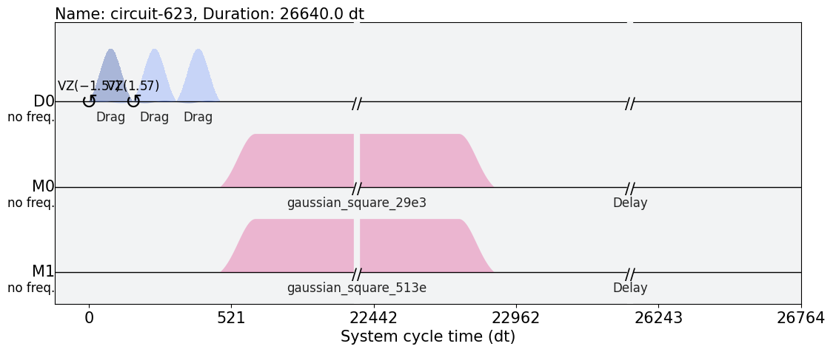
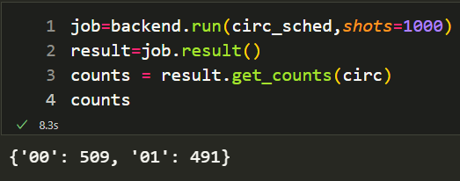
Hadamard gate circuit
Hadamard
Hadamard pulse
Check Hadamard gate well-defined
Readout pulse

Slide 13
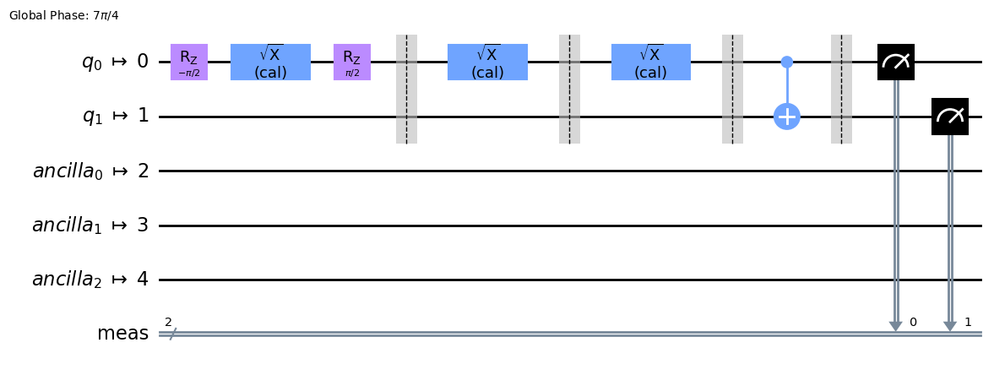
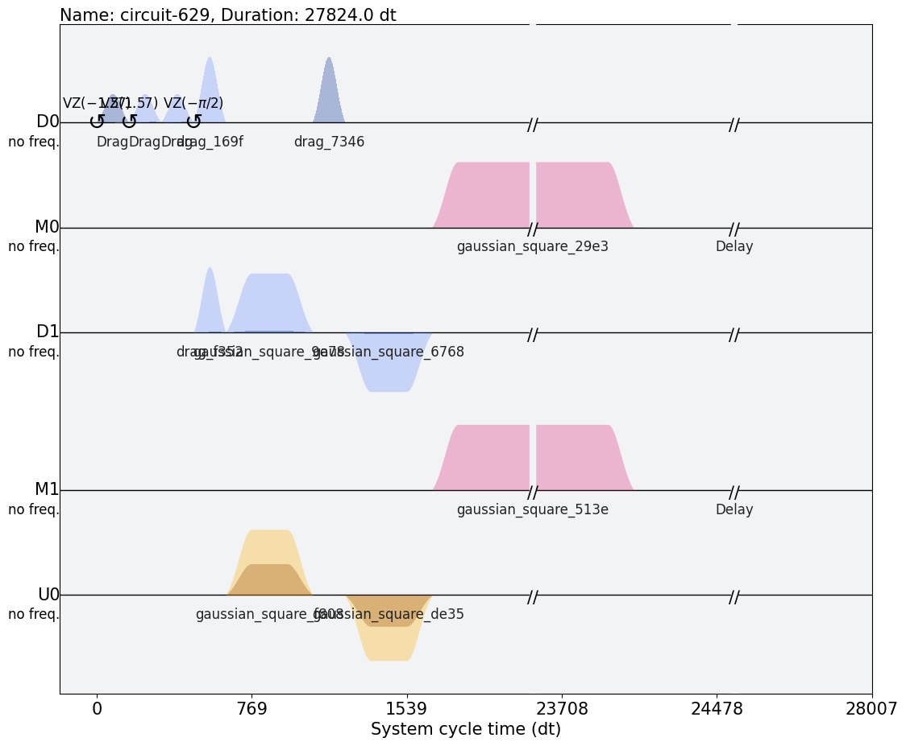
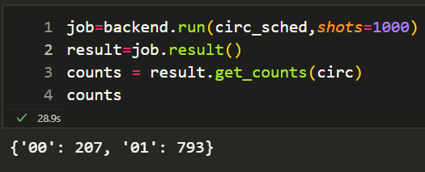
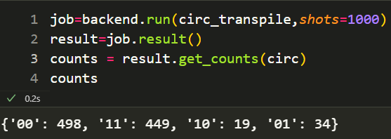
Bell state circuit
Hadamard
Plus CNOT
Hadamard pulse
Readout pulse
CNOT pulse

Slide 14
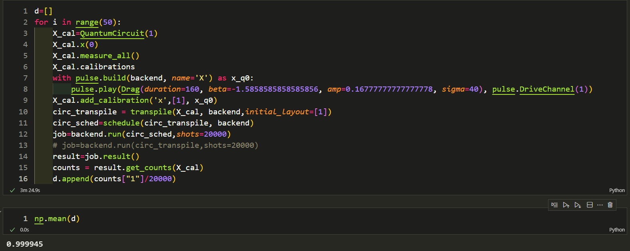
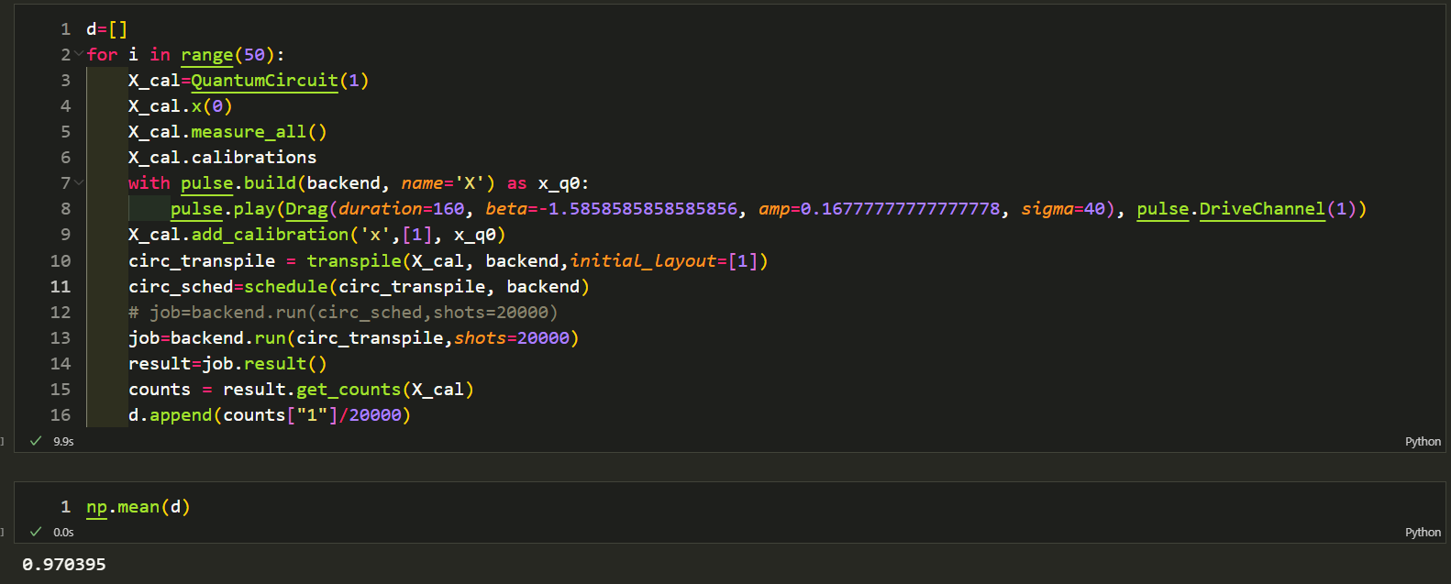
With schedule ➔ calibration applied
Without schedule ➔ calibration not applied

